Slide 1
Load & stress testing

Slide 2
Problems with manual load and stress testing
There are some problems with manual load & stress testing, for example:
It’s needed to recruit a huge number of people for the concurrent load test. It costs a lot of money and frankly, not possible.
The tests won’t be uniform, people can’t do the same exact test in the exact same way.
It is hard to collect all the output data for each of the participants.
This is why we use automatic load and stress tests.

Slide 3
What is load test?
Load test is a process of putting demand on a system and measuring the response.
In this test the analyst will test if the system functions correctly and according to specs under certain number of concurrent users that access the system (i.e. a website).
The output is statistics about the hardware and software performance its include: CPU, memory, disk IO of the physical server and response time, etc.

Slide 4
What is stress test?
Stress testing (sometimes called torture testing) is a form of deliberately intense or thorough testing used to determine the stability of a given system or entity. It involves testing beyond normal operational capacity, often to a breaking point, in order to observe the results. Reasons can include:
to determine breaking points or safe usage limits.
to confirm mathematical model is accurate enough in predicting breaking points or safe usage limits.
to confirm intended specifications are being met.
to determine modes of failure (how exactly a system fails).
to test stable operation of a part or system outside standard usage.

Slide 5
JMeter
We chose to use Jmeter for load and stress tests cause it’s relatively simple.

Slide 6

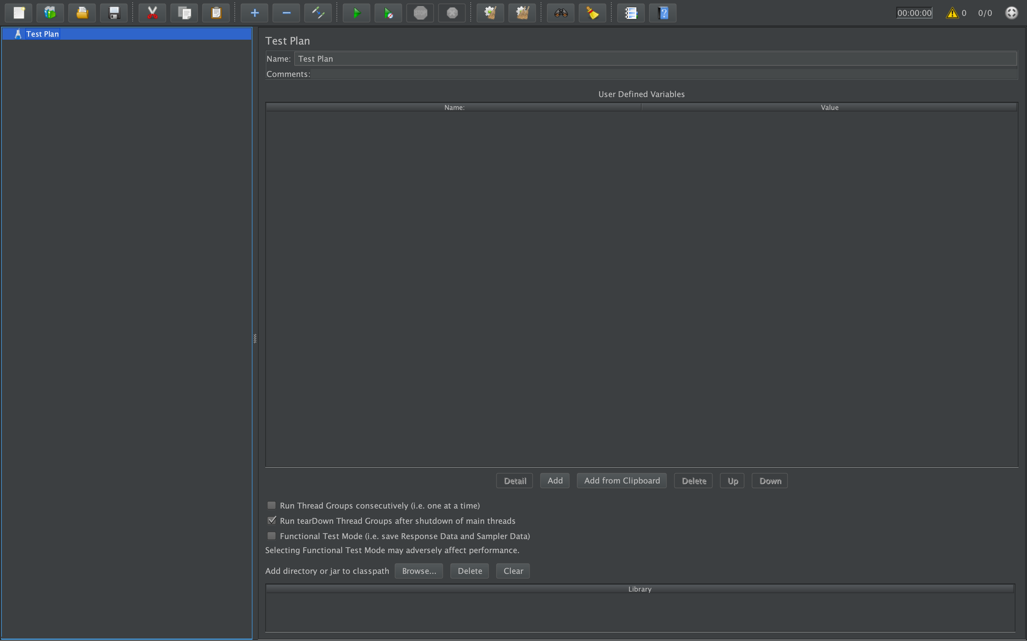
demo

Slide 7
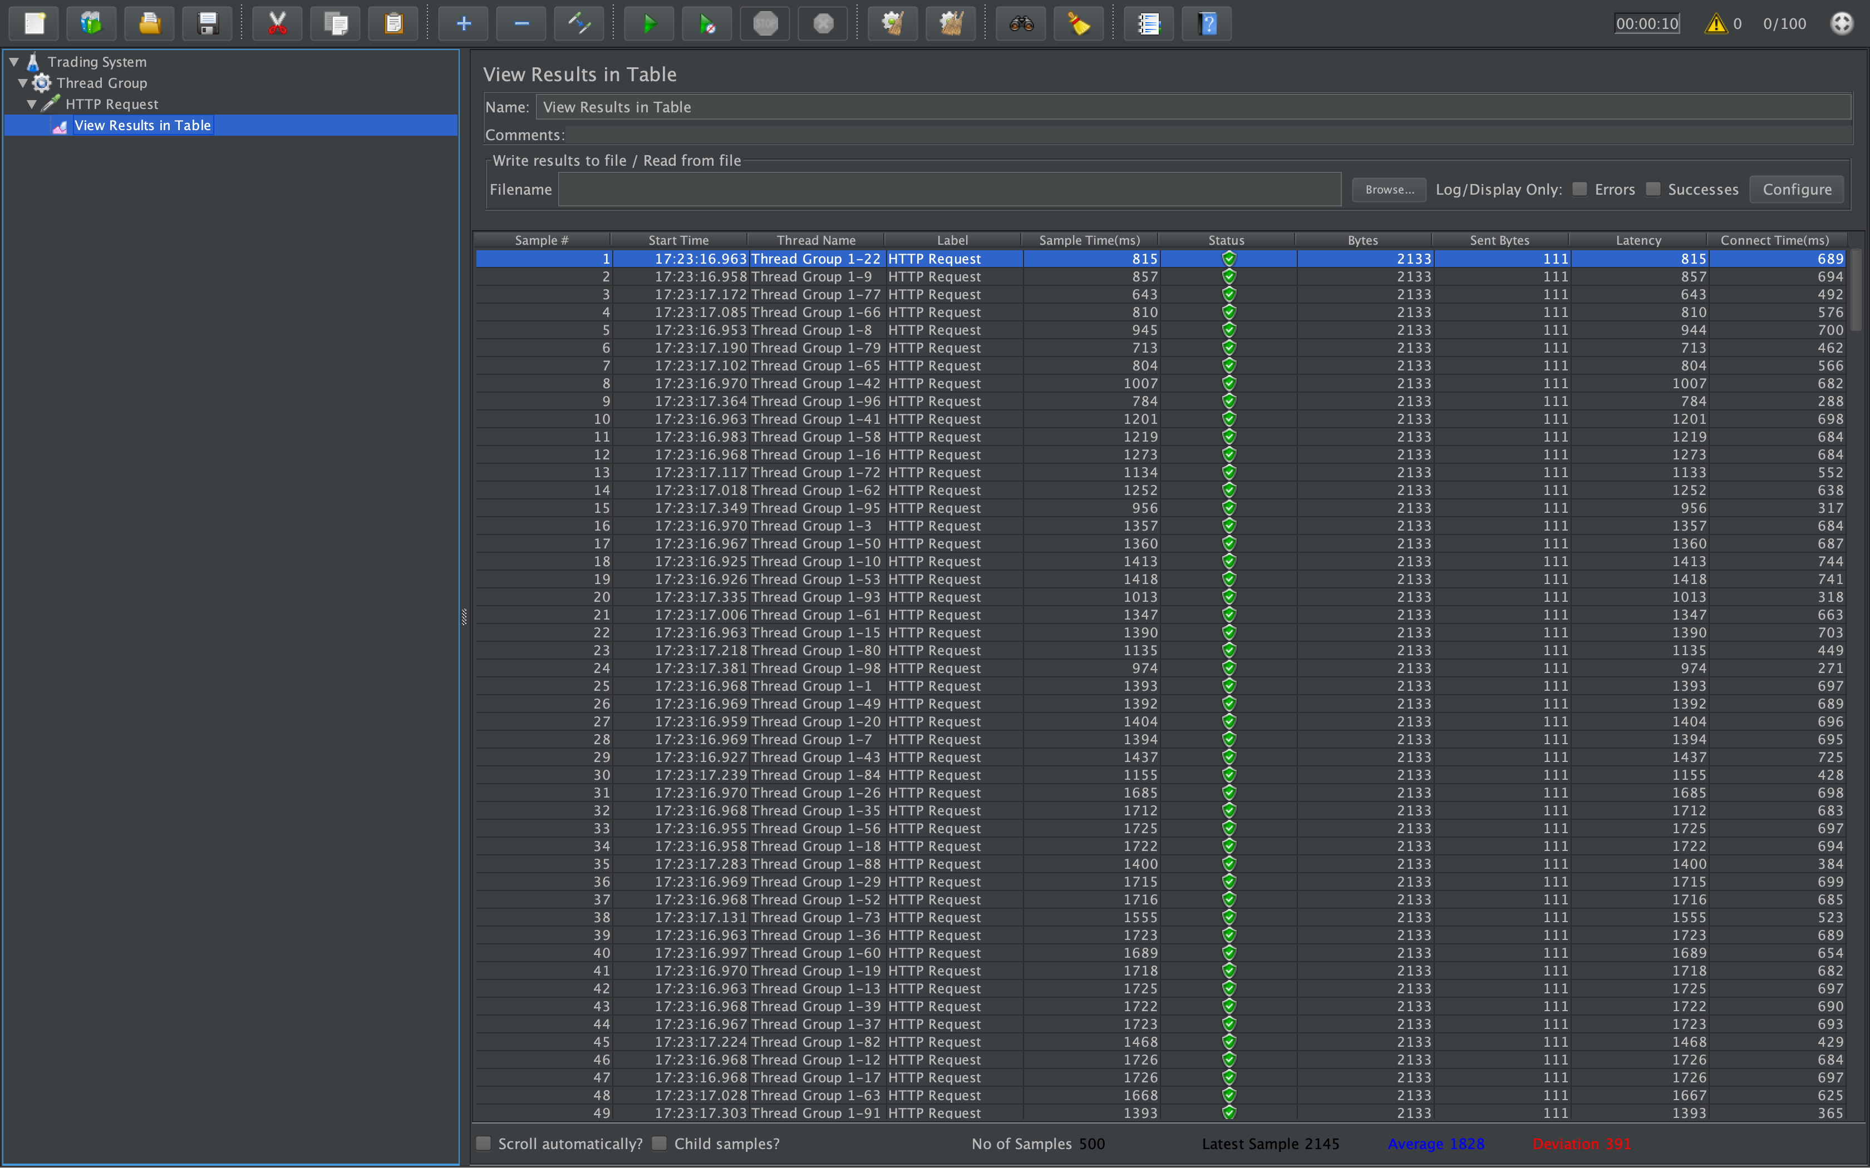
demo

Slide 8
Usecase cenarios
We can use it for simulating lots of purcheses.
Also for simultaneous logins.
And almose every aspect of our website.

